Slide 1

Comparative analysis of DNA Sequencing using Fourier Power Spectrum
Group Members:- Submitted To:-
Anuj Kumar Dr Sanjeev Narayan Sharma
Akash Dixit
Rohit Kumar
Satyakam Maurya
Upadhyay Paras Bhuwan

Slide 2

Table Of contents
Introduction
DNA Sequencing
Fourier power spectrum and it’s application
Result
Conclusion
References

Slide 3

Introduction
DNA sequencing is the determination of the precise sequence of nucleotides in a sample of DNA
It is used widely in many fields such as in the field of biotechnology, forensic biology ,in diagnostic.
Ultimately, DNA sequencing will become a part of a patient's medical record, helping physicians to determine the patient's risk of certain diseases and the optimal treatments

Slide 4
Methods of DNA Sequencing
There are four methods by which we can do DNA sequencing:
Ramanujan Fourier Transform
Fourier Power Spectrum
Nucleotide based Fourier Power Transform
Fractional Fourier Transform

Slide 5
Fourier Power Spectrum
Discrete Fourier Transform (DFT) In time domain, representation of digital signals describes the signal amplitude versus the sampling time instant or the sample number.
However, in some applications, signal frequency content is very useful otherwise than as digital signal samples.
The representation of the digital signal in terms of its frequency component in a frequency domain is called the signal spectrum.

Slide 6
Fourier Power Spectrum of DNA Sequence
A DFT power spectrum of a DNA sequence reflects the nucleotide distribution and periodic patterns of that sequence, and it has been applied to identify protein coding regions in genomic sequences.
In this paper we provide a new alignment-free method to classify DNA sequences based on the DFT power spectrum.
The method is tested and compared to other state-of-the-art methods on various datasets for speed and accuracy.

Slide 7
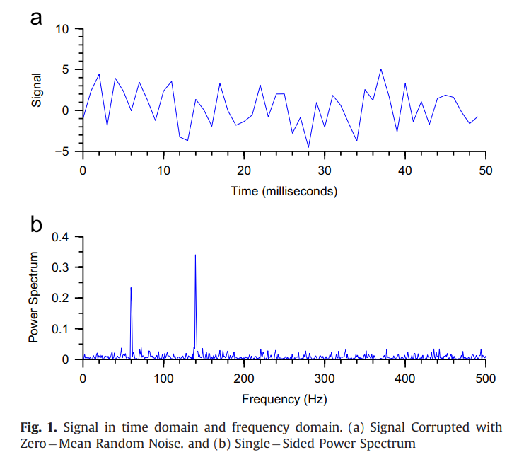

Fig.1 illustrates the time domain representation of a 1,000-Hz sinusoid with 32 samples at a sampling rate of 8,000 Hz; and the signal spectrum (frequency domain representation),where the amplitude peak is located at the frequency of 1,000 Hz in the calculated spectrum. Hence, the spectral plot better displays frequency information of a digital signal.

Slide 8
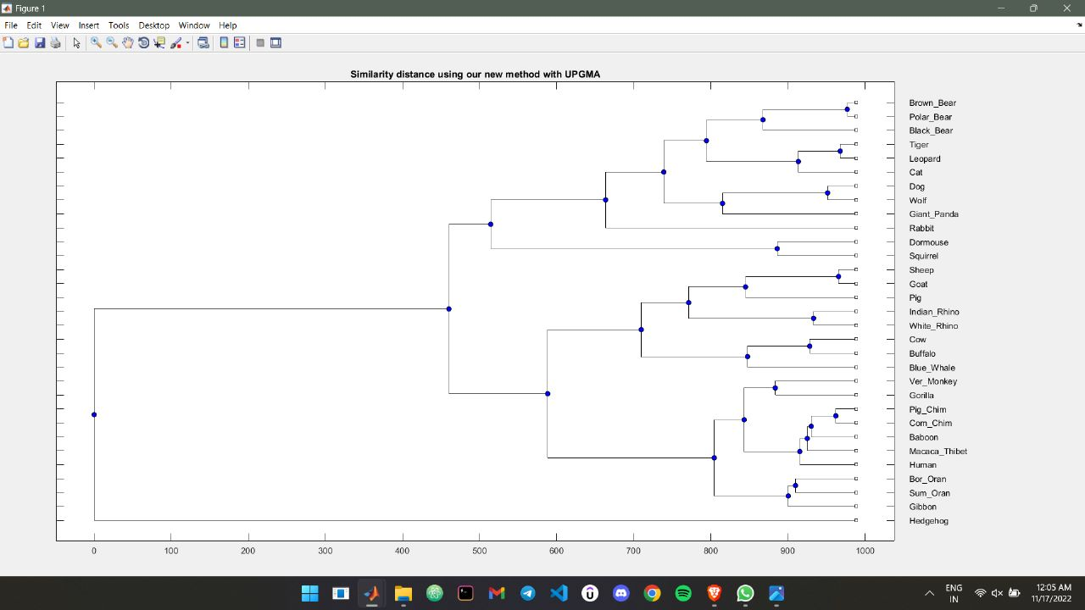
Result

Slide 9
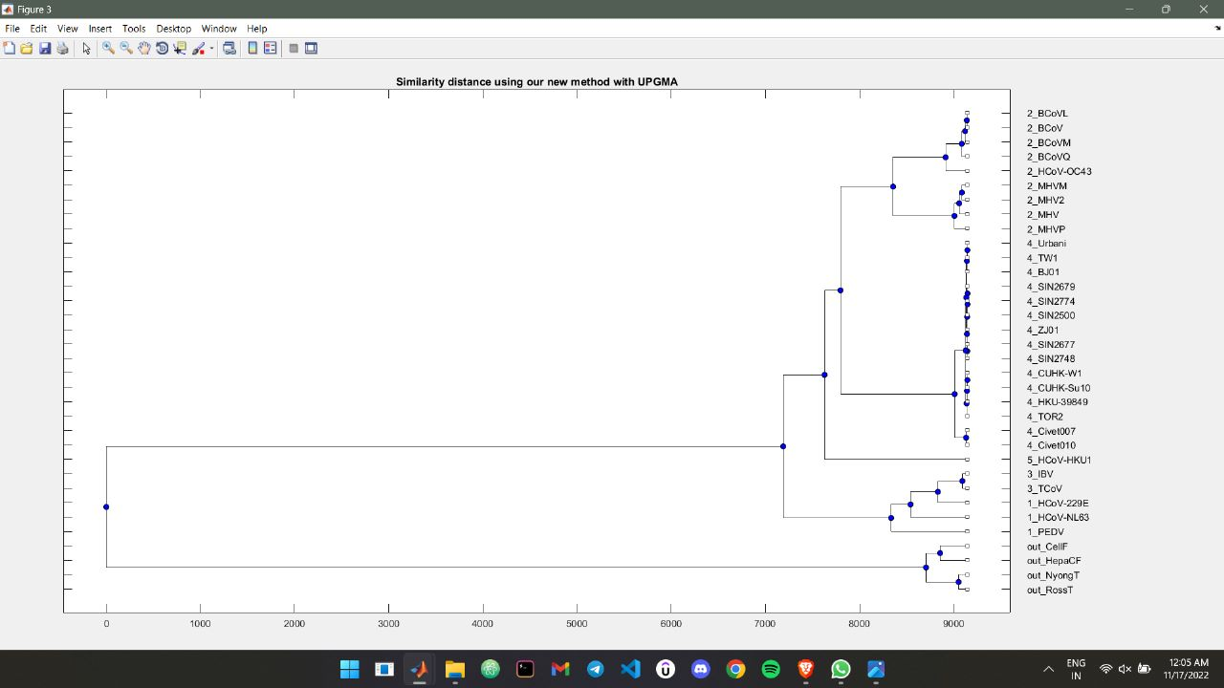
Result

Slide 10
Conclusion
In this work, we have established an effective similarity measure of DNA sequences based on DFT. We first performed DFT on DNA sequence after converting symbolic sequences to four binary indicator sequences. Euclidean distance is used to calculate the similarity of DFT coefficients. We conducted different DNA sequence mutants and assess the accuracy of the new DFT metric on the mutants. The similarity metrics have been evaluated by constructing phylogenetic trees of virus at gene levels. Our work provides encouraging steps for applying the rediscovered DFT approach for effective comparative studies on biological sequences.

Slide 11
References
Altschul S.F., Madden, T.L., Schaffer, A.A., Zhang, J., Zhang, Z., Miller, W., and Lipman, D.J. 1997. Gapped BLAST and PSI-BLAST: A new generation of protein database search programs. Nucleic Acids Res. 25: 3389-3402. [PMC free article] [PubMed] [Google Scholar]
Aparicio S., Chapman, J., Stupka, E., Putnam, N., Chia, J.M., Dehal, P., Christoffels, A., Rash, S., Hoon, S., Smit, A., et al. 2002. Whole-genome shotgun assembly and analysis of the genome of Fugu rubripes. Science 297: 1283-1285. [PubMed] [Google Scholar]
Batzoglou S., Pachter, L., Mesirov, J.P., Berger, B., and Lander, E.S. 2000. Human and mouse gene structure: Comparative analysis and application to exon prediction. Genome Res. 10: 950-958. [PMC free article] [PubMed] [Google Scholar]

Slide 12

THANK YOU!

